Slide 1

Smart FIR lodging architecture with the help of blockchain and IPFS
Soham Banerjee 201010250 Anubhav Garg 201000007
Sudhanshu Tripathi 201010252
Supervisor:
Dr. Ruhul Amin
Dr. Shyama Prasad Mukherjee
International Institute of Information Technology Naya Raipur

Slide 2

Contents
Introduction
Issues to be addressed
Technology used in our project
Existing solutions
Our Additions
The proposed solution
Results
References

Slide 3

Introduction
In Indian law, any offense, whether cognizable or non-cognizable, an FIR has to be lodged with the Police Station for any further action. In some cases, where a complaint case is filed, FIR can be ignored.

Slide 4
Issues we are addressing
The traditional system of Police Complaints
Issues in the traditional system of Police Complaints
We resolve this issue using Blockchain
Notes:
A fiber-optic cable, also known as an optical-fiber cable is a Guided Communication medium, is an assembly similar to an electrical broadband cable, but containing one or more optical fibers that are used to carry light or EM signals.
Core
The core carries the light. It is the smallest and most important part of the optical fiber. The core of the optical fiber is usually made of glass although some are of plastic. Used in the core, is a highly pure silicon dioxide (Si02), a very clear material. Refractive index is raised under controlled conditions through dopants such as Germania, phosphorous pentoxide, or alumina during manufacturing.
There’s no specific diameters for optical fiber cores as different sizes depend on the application. The range of usual glass cores is from as small as 3.7um up to 200um. For telecommunication, core sizes usually used is 9um, 50um and 62.5um. there is majorly two types of optical fiber which include the single-mode fiber and the multimode fiber based on the core sizes.
Single-mode fiber is one with 8 to 10 microns which lets light travels towards the center of the core in a single wavelength.
Multimode fiber is characterized with 50 or 62.5 microns.
On the other hand, optical fiber cores made of plastic are larger.
Cladding
The cladding covers the core. Its refractive index is lower to ensure the optical fiber works. The cladding and the core are manufactured together from the same silicon dioxide-based material in a permanently fused state whenever the glass cladding is used. A difference in refractive indexes of about 1% is maintained due to different amounts of dopants being added to the core and the cladding during the manufacturing process. Although the numbers are dependent upon the wavelength, the usual core is likely to have a refractive index of 1,49 at 1300nm while that of the cladding is 1.47.
The cladding is manufactured, using standard diameters. Two mostly used diameters are 125um and 140um. Core sizes such as 9um, 50um, and 62.5um, are typically supported by the 125um cladding while 140um cladding has 100um.
Coating
This is more like the protective layer of the optical fiber. It protects the cladding from damage by way of engrossing the shocks, nicks, scrapes, and even moisture that could damage the cladding. Without the coating, an optical fiber is very fragile. Glasss fibers are not sold without the coating because they are essential for protection. The diameter of the coating is usually of 250um or 500um. Naturally the coating is colourless; although some applications prefers to colour it easily.

Slide 5

Technology used in our project
Blockchain
Smart Contract
InterPlanetary File System (IPFS)
Cryptography
Notes:
Whenever a ray of light travels from optically denser medium to optically rarer medium, Total Internal Reflection (TIR) takes place. In the given media like glass, water etc. the ray of light continues to get reflected.
As the ray is travelling from a medium of higher refractive index to a medium with a lower refractive index, the ray of light will move away from the normal.

Slide 6
Literature Review
S.No. | Authors | Summary | Drawbacks
1. | ¹Hingorani et al. | FIR details and ‘proof of complaint filing’ stored in IFPS. Maximum possible information about FIRs, is stored for police authorities to remain under the pressure of lawfully lodging the same, and start an investigation at the earliest | Overly simplified and impractical. Focuses more on penalizing the policemen rather than looking at uprooting the entire scope of mishandling FIRs. Cycle of complaints -> infinitely.
Notes:
Now i am going to explain about a research which addressing this king of eavesdropper attack.

Slide 7
Literature Review
S.No. | Authors | Summary | Drawbacks
2. | ² Arnab Mukherjee et al. | Implements Hyperledger. Storage of FIRs, forensic reports and investigative findings Aim : to provide secure and immutable storage mechanisms. | Focus on data storage only Project in proposal stage
Notes:
Now i am going to explain about a research which addressing this king of eavesdropper attack.

Slide 8
Literature Review
S.No. | Authors | Summary | Drawbacks
3. | ³ Hassija et al. | Mobile application Client (FIR) + policemen (case updates) -> Commissioner (block generation) –mining→competing miner nodes(policemen). Consortium Blockchain | Scope of fake FIR registration from invalid nodes. No measure to judge of the validity/ invalidity of users. Commissioner nodes act as fairly centralised architecture. Proposal is idealistic -> requires entire overhaul of existing system.
Notes:
Now i am going to explain about a research which addressing this king of eavesdropper attack.

Slide 9
Our Additions
User validation to safeguard against false FIR filing incidents.
Improve decentralisation focus of the architecture.
Streamline FIR lodging process
Notes:
Now i am going to explain about a research which addressing this king of eavesdropper attack.

Slide 10
The proposed Solution
User registration
Cryptographic account generation
Complaint register
Submitted to police station
Verification of the complaint
Creation of the block

Slide 11
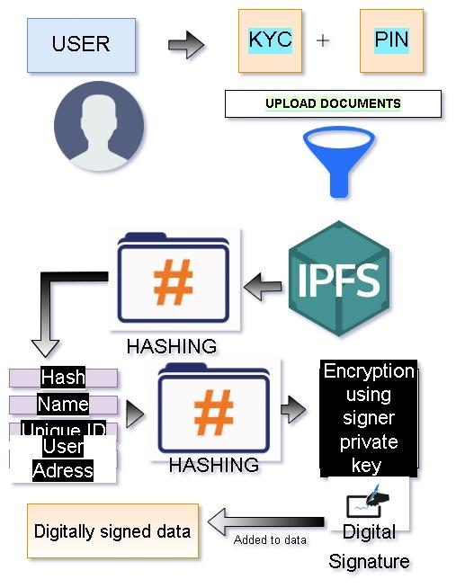
Project Model
Work Timeline

Slide 12
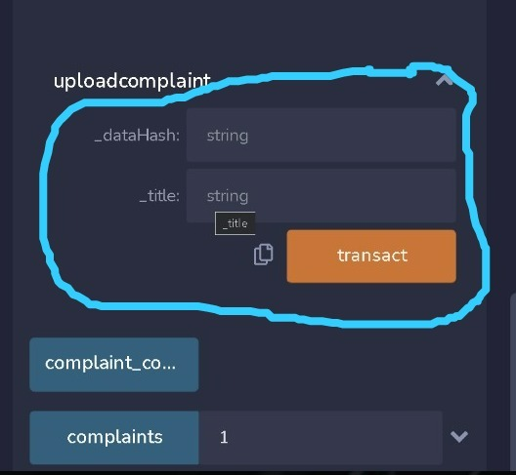
Results : Input
Work Timeline

Slide 13
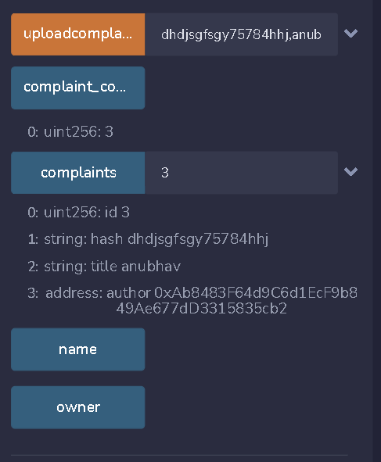
Results : output
Work Timeline

Slide 14
References
Hingorani, Ishwarlal & Khara, Rushabh & Pomendkar, Deepika & Raul, Nataasha. (2020). Police Complaint Management System using Blockchain Technology. 1214-1219. 10.1109/ICISS49785.2020.9315884.
Arnab Mukherjee and Raju Halder. 2020. PoliceChain: Blockchain-Based Smart Policing System for Smart Cities. In <i>13th International Conference on Security of Information and Networks</i> (<i>SIN 2020</i>). Association for Computing Machinery, New York, NY, USA, Article 6, 1–5. DOI:https://doi.org/10.1145/3433174.3433618
Hassija, Vikas & Patel, Aarya & Chamola, Vinay. (2021). Police FIR Registration and Tracking Using Consortium Blockchain. 10.1007/978-981-15-5243-4_75.

Slide 15
Thank You
Dr. Shyama Prasad Mukherjee
International Institute of Information Technology Naya Raipur

